Slide 1
EC 201 Electronics Devices and circuits I: PCC 4-0-0 4 credit
Introduction to Semiconductor
Band Theory of solids (Metal, semiconductors, Dielectrics), Energy bands in intrinsic and extrinsic semiconductors, Fermi function, equilibrium carrier concentrations and mas Action law, direct and indirect band-gap semiconductors. Carrier transport: diffusion current, drift current, mobility and resistivity, generation and recombination of carriers, Poisson and continuity equations, Hall Effect and its applications, Determine the Energy gap using tauc method.
Junction Formation: Metals-Semiconductor junctions, PN junctions.
Semiconductor Diodes: Band structure of pn junction, current components, Quantitative theory of pn diode, Volt-ampere characteristics and its temperature dependence, Narrow-base diode, Transition and diffusion capacitance of p-n junction diodes, Breakdown of junctions on Reverse Bias, Zener and Avalanche Breakdowns, Zener Diode, Tunnel Diode and Its V-I characteristics. The principles of photo diode, photo transistor, LED & LCD,
Application of Diodes: Diode as a rectifier, Half wave and Full wave, Half wave and Full wave with filters, Bridge rectifiers with and without filters, Ripple factor and regulation characteristics, photo diode, photo transistor, LED & LCD, Photo voltaic cell (solar cell).

Slide 2
Junction Transistor: PNP and NPN junction transistors, Characteristics of the current flow across the base regions, Minority and majority carrier profiles, Transistor as a device in CB, CE and CC configurations, and their characteristics, Ebers-Moll Model of BJT.
Transistor Biasing: The Operating Point, DC & AC Load Lines, Fixed Bias and Problems, Collector Feedback Bias, Emitter Feed Back Bias, Self-Bias and Problems, Stabilization, Various Stabilization Circuits, Thermal Runaway and Thermal Stability.
Field Effect Transistors: JFET and its characteristics, Pinch off voltage and drain saturation current, MOS Capacitor, MOSFET: enhancement, depletion modes, Biasing of FETs, CV characteristics, Thin Film Transistors (TFTS), FINFET, vacuum transistors (latest technology currently used in semiconductor industry).
Small Signal Low Frequency Transistor Amplifier Circuits: Transistor hybrid model, Analysis of transistor amplifier circuits using ‘h’ parameters, Conversion formulae for the parameters of the three configurations, Analysis of single stage transistor amplifier circuits, RC coupled amplifier. Effect of bypass and coupling capacitors on the low frequency response of the amplifier, Emitter follower amplifier, FET amplifiers - low frequency and high frequency models, Amplifier configurations, Low and high frequency response of amplifier circuits, Analysis of single stage FET amplifier circuits.

Slide 3
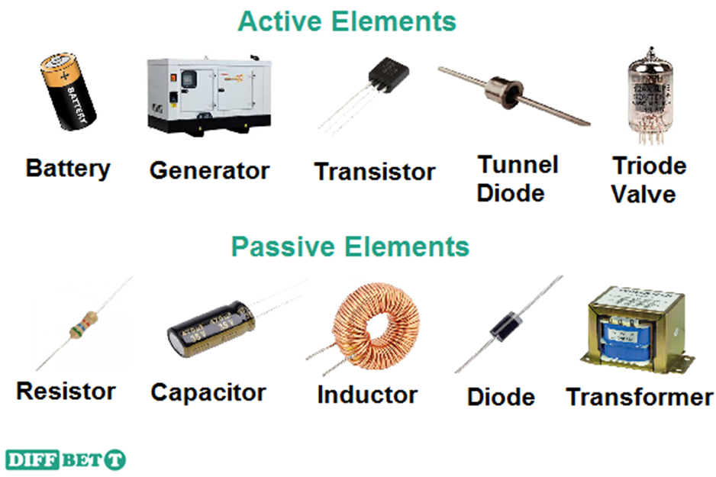
Active and Passive components
Active components are parts of a circuit that rely on an external power source to control or modify electrical signals. Active components such as transistors and silicon-controlled rectifiers (SCRs) use electricity to control electricity.
Passive components like resistors, transformers, and diodes don’t need an external power source to function. These components use some other property to control the electrical signal.

Slide 4
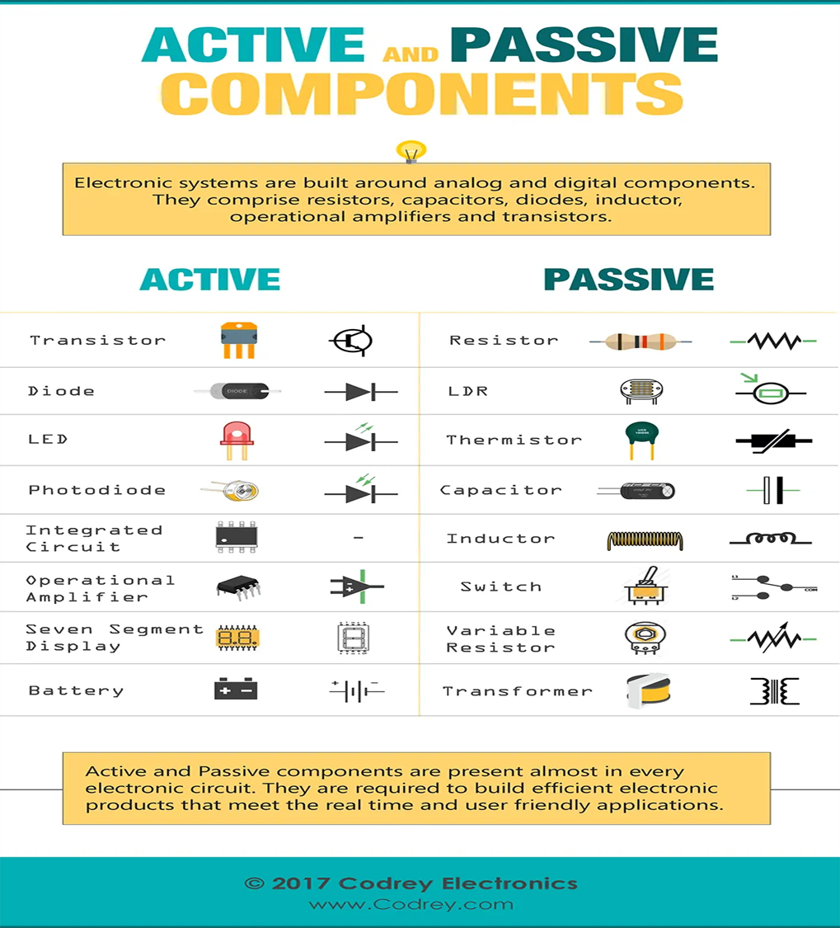

Slide 5
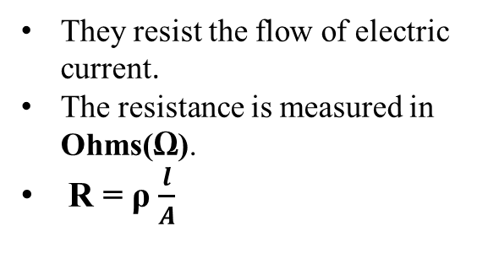
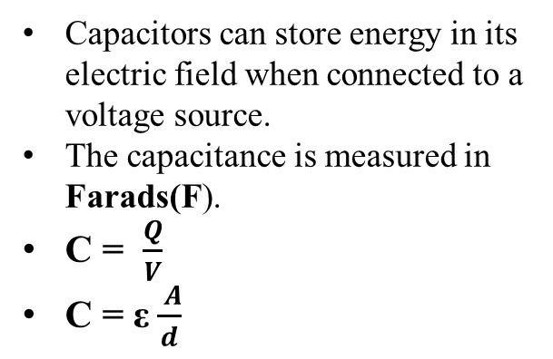
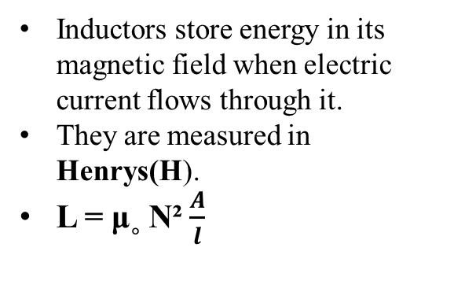
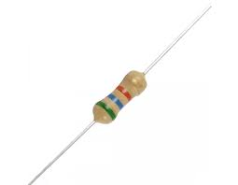
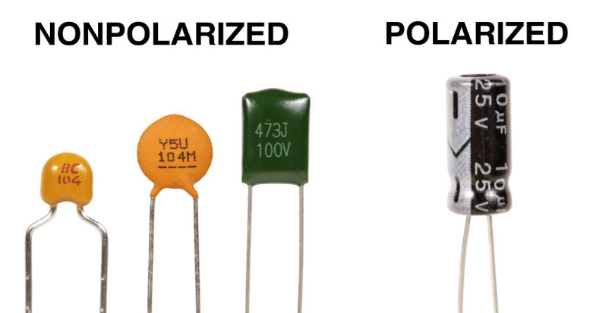
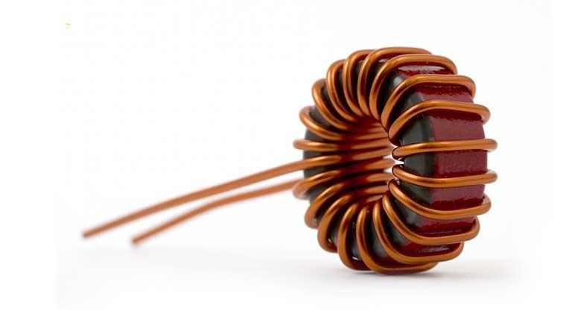
Passive components
Passive components are electronic components that do not require a source of energy to perform their functions.
Resistors
Capacitors
Inductors

Slide 6
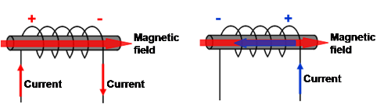
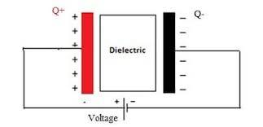
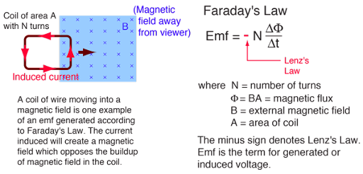
Inductor
Working Principle behind inductor is Lenz’s law
Lenz's law states that the current induced in a circuit due to a change or a motion in a magnetic field is so directed as to oppose the change in flux and to exert a mechanical force opposing the motion.
Principle of Working
Capacitor
When a potential difference is applied across the plates of capacitor the dielectric material get polarised and one plate will get positively charged and the other will get negatively charged.

Slide 7
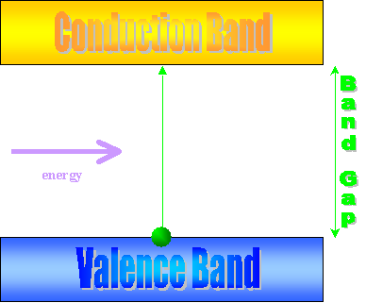
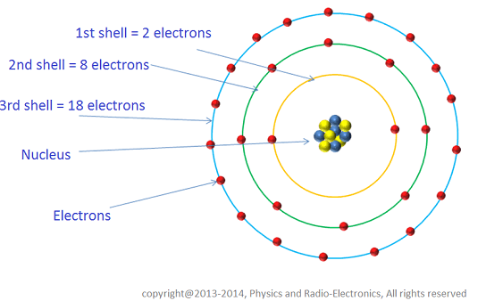
Scientific Principle of Conduction
Solids, which are composed of a large number of atoms (about 1023), thus have a large number of orbitals occupying a large number of newly separated energy levels called energy bands.
The energy levels are quantized and there are certain energies that the electrons can never possess called the forbidden energy levels (energy band gap).

Slide 8
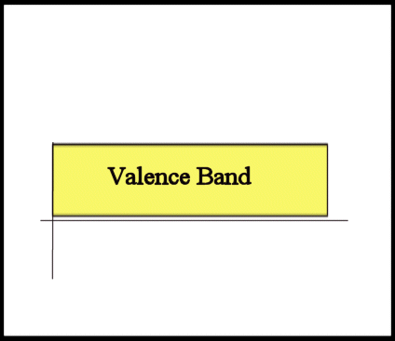
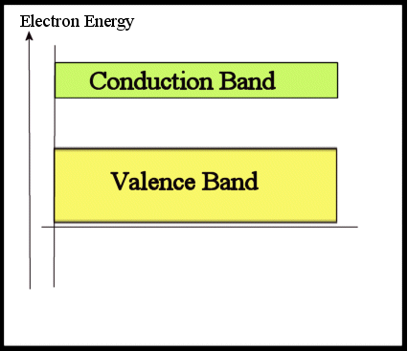
Valence Band and conduction band
At 0K temperature, all the energy levels associated with the electrons bound to a nucleus are fully occupied. The highest band of these occupied energy levels constitutes what is called the valence band.
When the electrons absorb energy (at higher temperatures, due to interaction with high energy photons, etc.) and escape the nucleus of the atom, they are free to move in material. The band of energies the free electrons may occupy is defined as the conduction band.

Slide 9
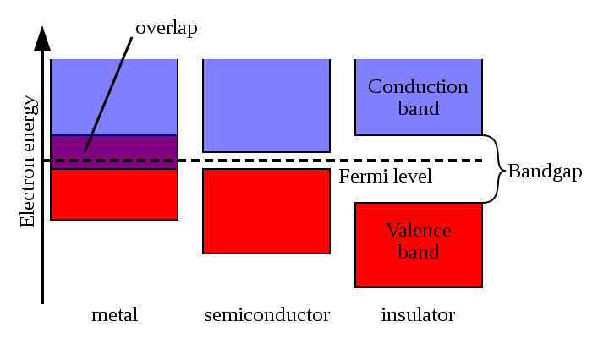
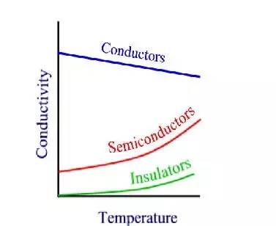
Band Diagrams

Slide 10
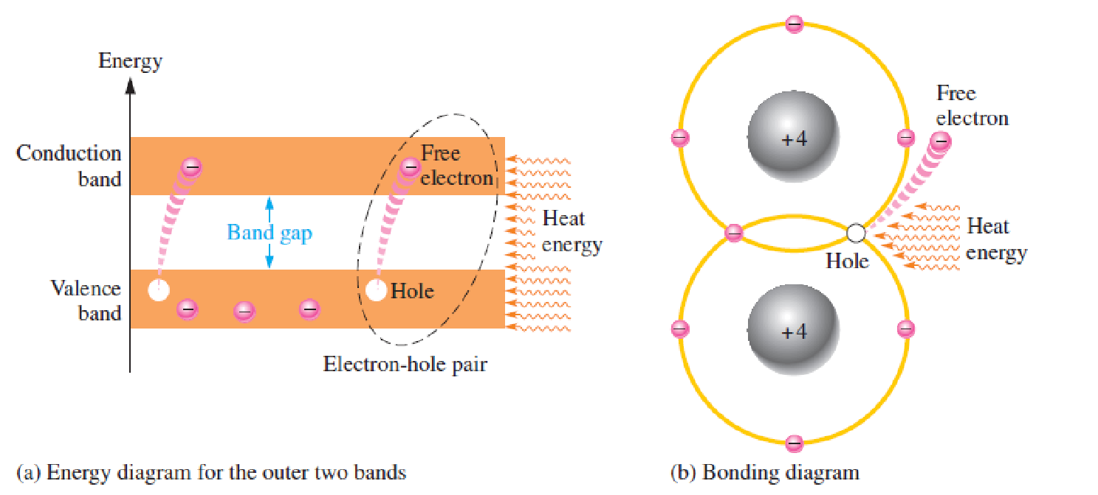
Carriers
The electrons present in the valence band correspond to the electrons involved in the bonding and are therefore not involved in charge transport.
when a bond is broken, the associated electron is free and can contribute to charge transport. These free electrons occupy states in the conduction band.
When the bonds of the semiconductor lattice are broken, electrons are pushed to the conduction band, and leave behind vacancies called holes.

Slide 11

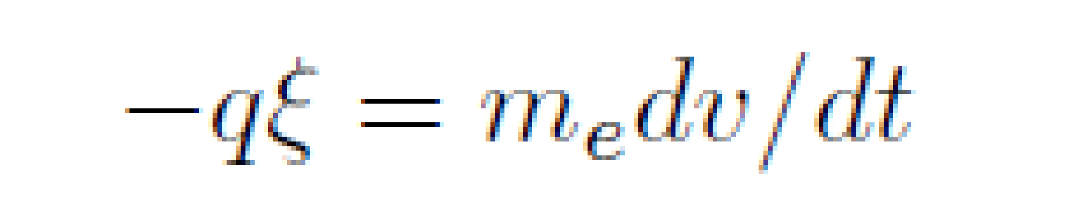
Elective Mass
When an electron is placed in vacuum in a uniform electric field the velocity of the electron,
v, is related to the field as where m_{e} is the mass of the electron.
when the electrons move in the semiconductor lattice under the presence of an electric field or magnetic field, then mass of the electrons varies with velocity. This means the mass of the action in the function of velocity and its terms effective mass of the electrons

Slide 12
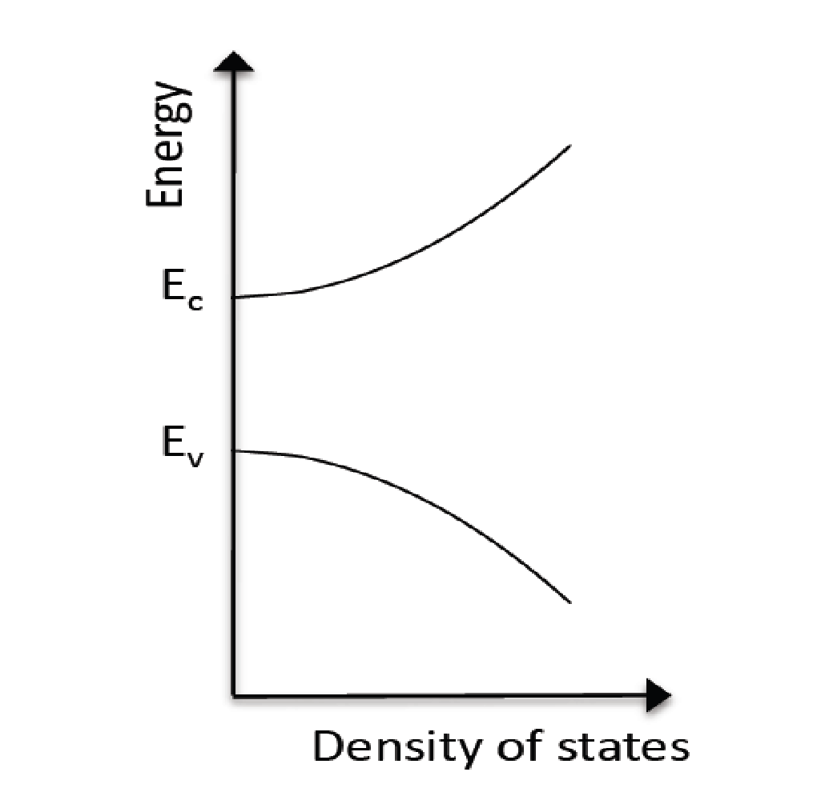
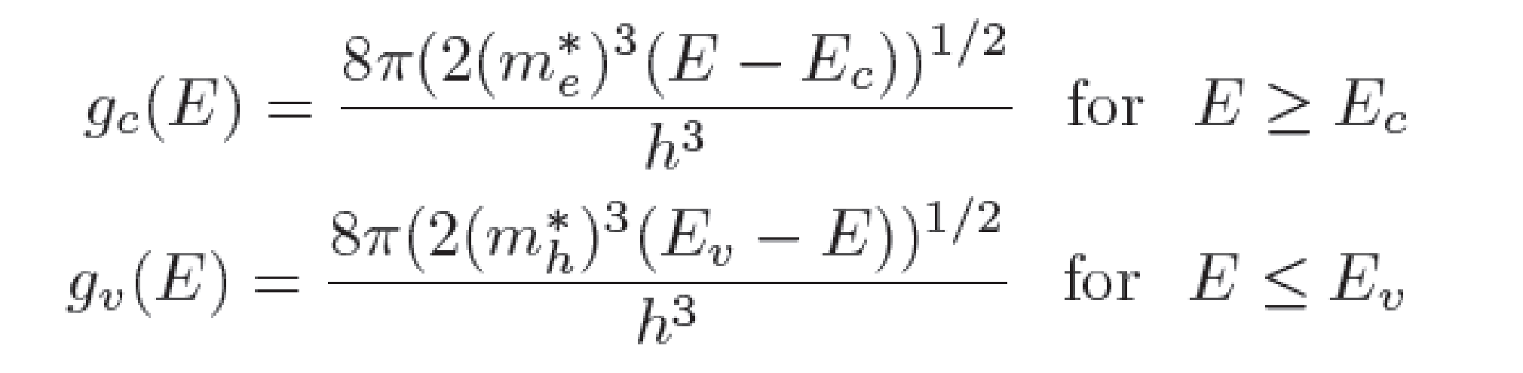
Density of States
The density of states in the semiconductor defines the number of states an electron can occupy
The density of states in the conduction and valence bands are given by
Nature of the density of states in a semiconductor assuming equal effective
masses for electrons and holes.

Slide 13
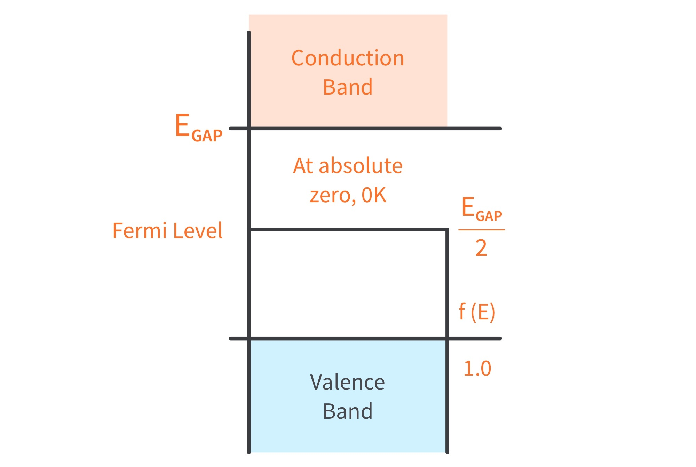
The Fermi Level and Fermi Function
The Fermi level determines the probability of electron occupancy at different energy levels. The closer the Fermi level is to the conduction band energy, the easier it will be for electrons in the valence band to transition into the conduction band.
The Fermi function, f(E), defines the probability of finding an electron at a given energy level E.
Equivalently, the probability of finding holes at the energy level E is given by 1-f(E). The Fermi function is therefore a probability density function,

Slide 14
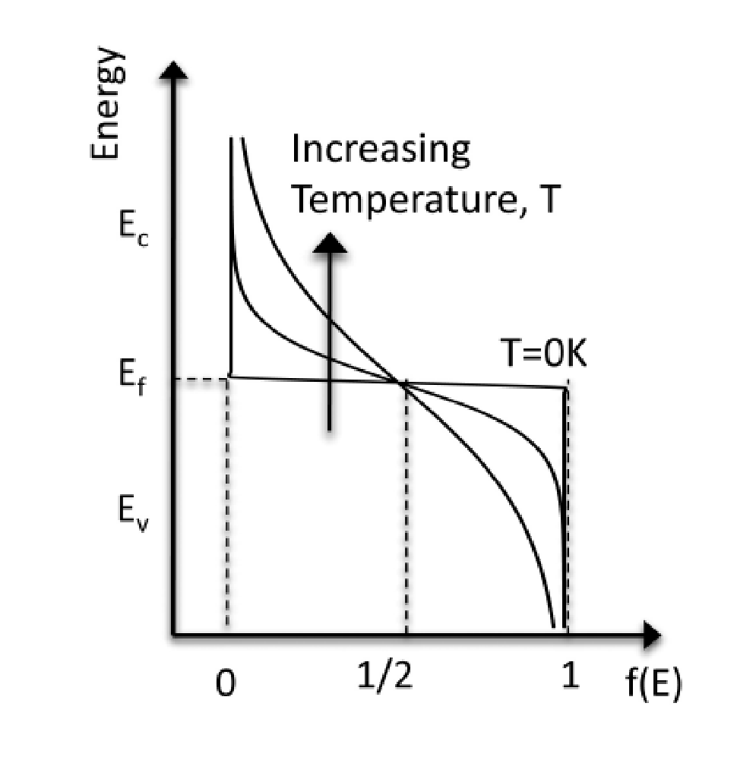
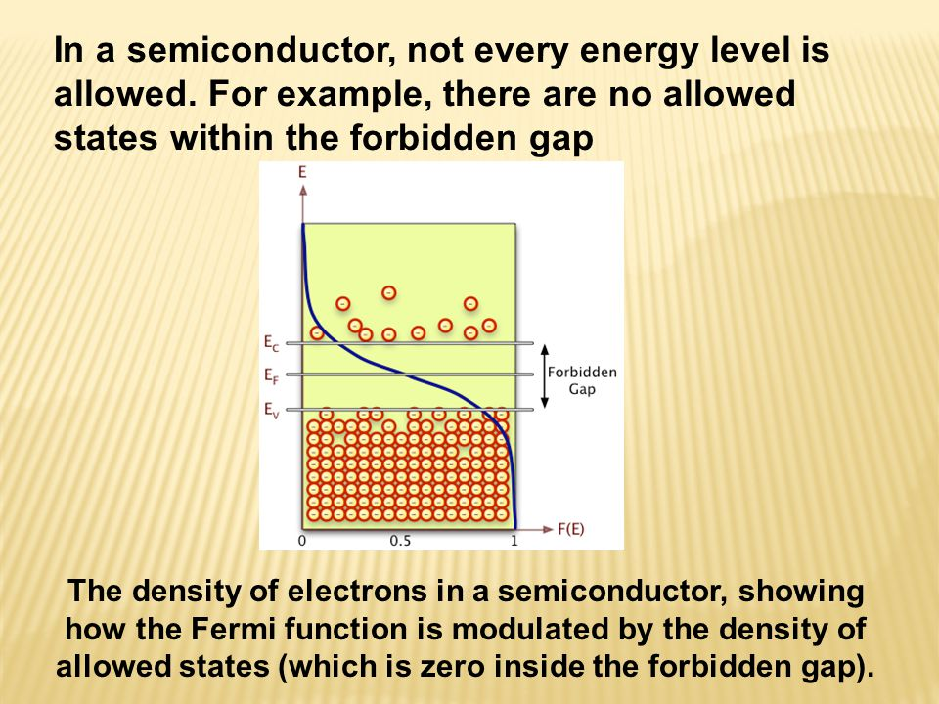
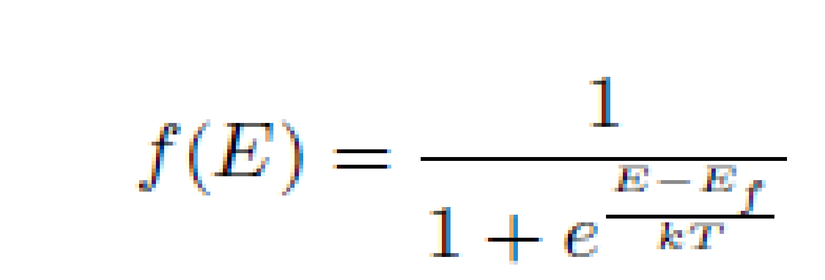
The Fermi Level and Fermi Function
the Fermi level is the energy level at which the
probability of finding an electron is exactly 1/2 at any temperature
The Fermi function at different
temperatures. The value of the
Fermi function is always
1/2 at the Fermi level.
At 0K,
the probability of finding an electron below the Fermi level is 1 while the probability of finding an electron above the Fermi level is 0.

Slide 15
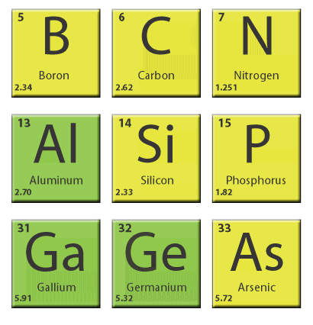
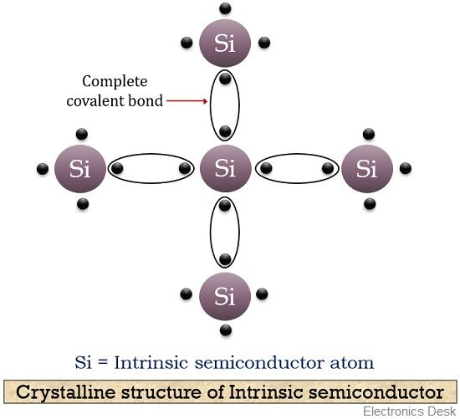

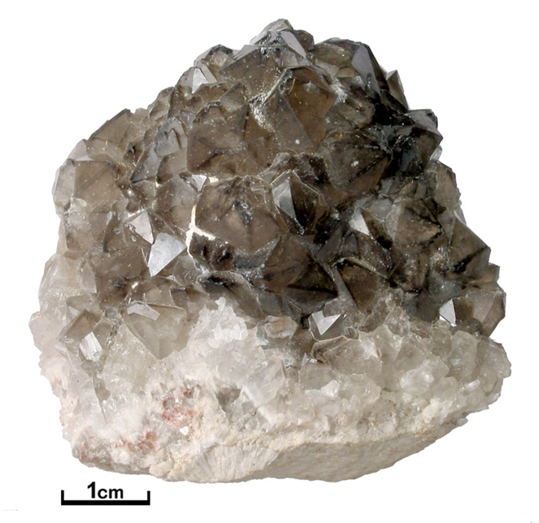
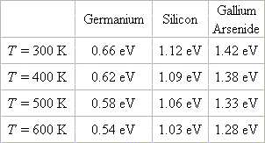
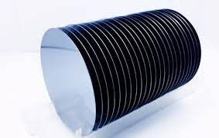
Silicon

Slide 16
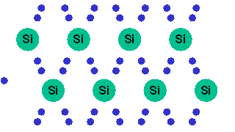
Intrinsic Silicon

Slide 17
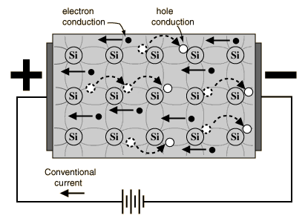
Current Flow
If a voltage is applied, then both the electron and the hole can contribute to a small current flow.

Slide 18
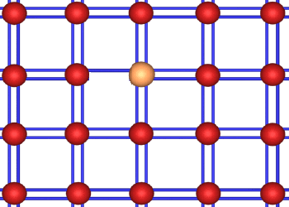
Extrinsic semiconductor (Doping)
Doping (adding an impurity) can produce 2 types of semi-conductors depending upon the element added.

Slide 19
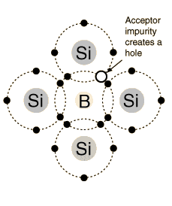
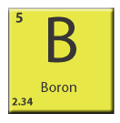
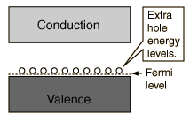
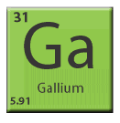
P-Type Doping
In P-type doping, boron or
gallium is the dopant.
Holes can conduct current Holes accept electron
from a neighbor, moving the hole over a space

Slide 20
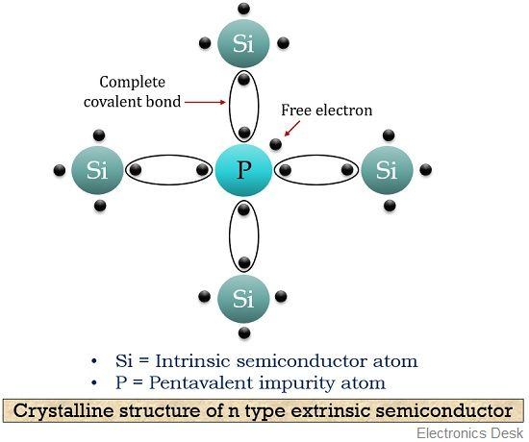
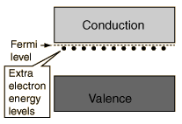
N-Type doping
Electrons have a negative charge
Phosphorus and arsenic each have five outer electrons,
so they're out of place when they get into the silicon lattice.

Slide 21
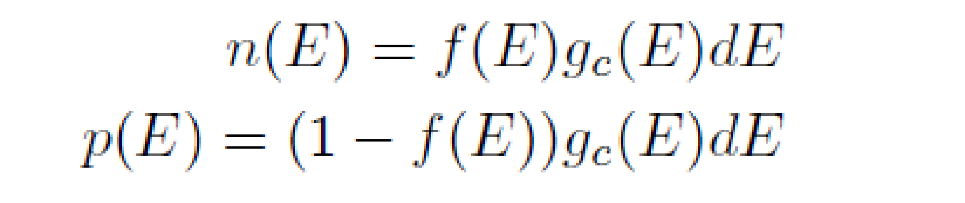
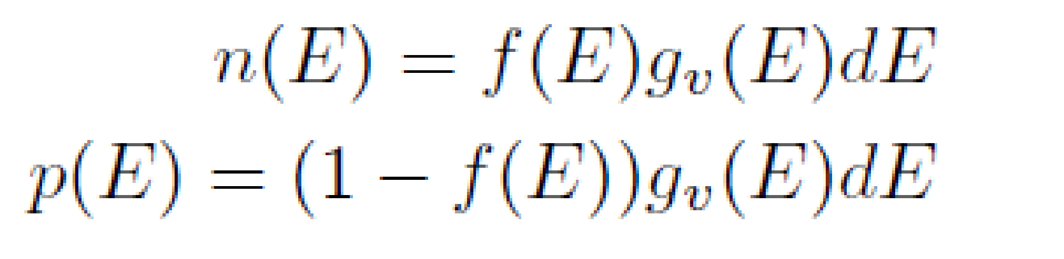
Number of Carriers
Therefore, the number of electrons and holes found between the energy levels E and E + dE in the conduction band is given by
Therefore, the number of electrons and holes found between the energy levels E and E + dE in the valence band is given by

Slide 22
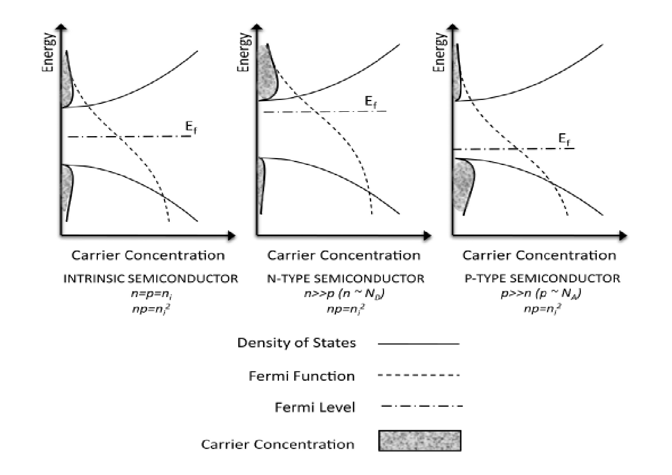
The free carrier density for an Intrinsic and Extrinsic semiconductor

Slide 23
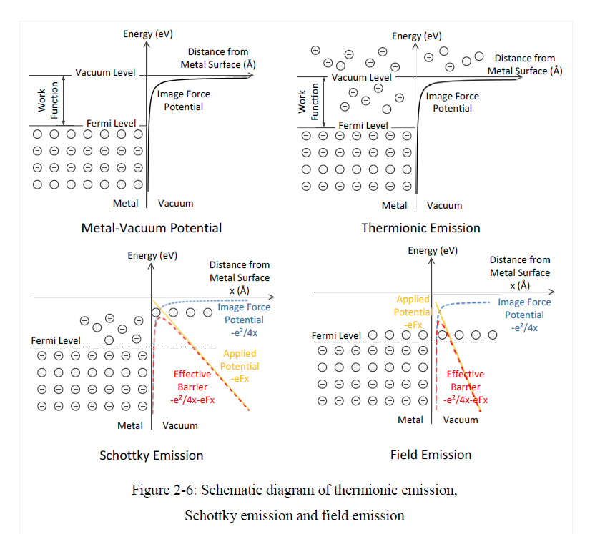

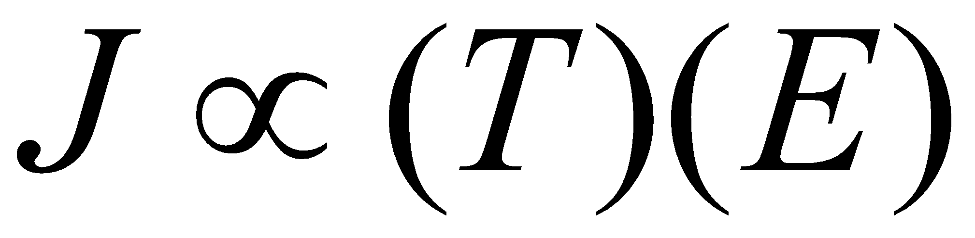
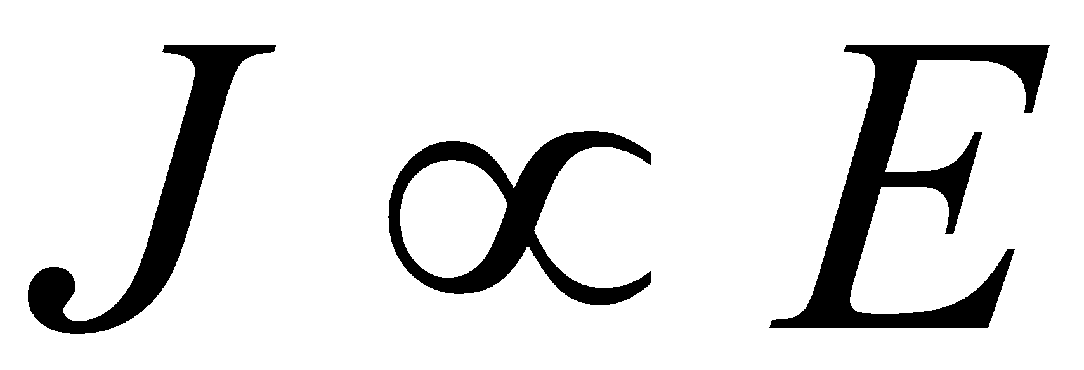
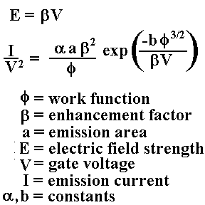
EMISSION OF ELECTRON FROM METALS
Nanotube field electron emission: principle ,development, and applications. Yunhan Li1,et al Nanotechnology 26 (2015) 242001 (23pp)

Slide 24
Junction formation
Metal –Metal formation
Semiconductor- Metal formation
Semiconductor- semiconductor formation

Slide 25
Metal -Semiconductor Junction
Depending on the semiconductor and metal used, the contact may be rectifying or ohmic.
A rectifying contact allows current to pass in one direction only while it blocks the movement of carriers in the opposite direction.
An ohmic contact allows current to pass in either direction.
If the semiconductor is n-type with Ф_{S} < Ф_{M} or if it is p-type with Ф_{S} > Ф_{M} the contact formed is rectifying or blocking.
If the semiconductor is n-type with Ф_{S} >Ф_{M} or if it is p-type with Ф_{S} < Ф_{M} the contact formed is ohmic .

Slide 26
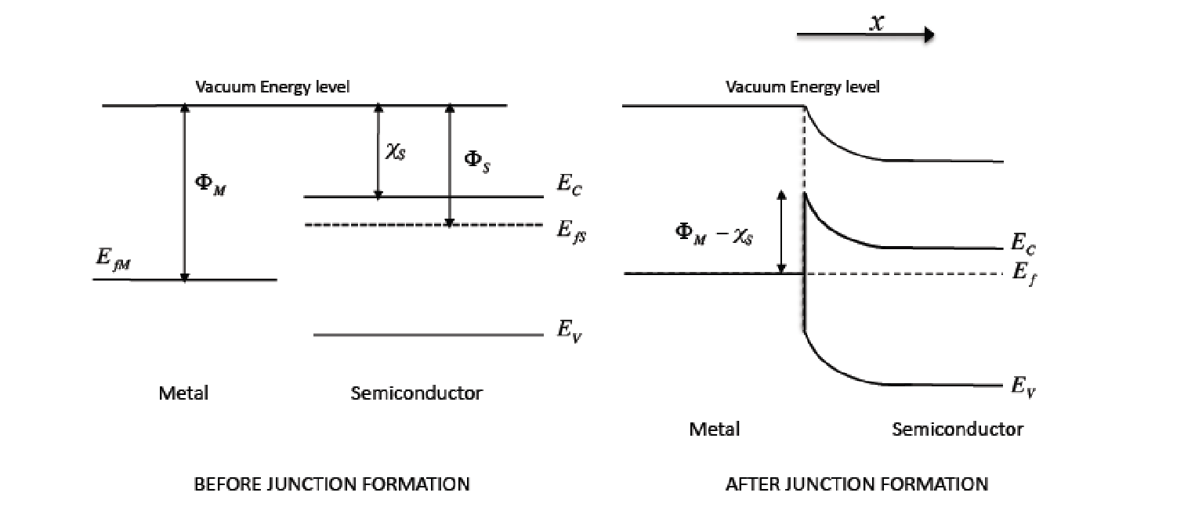
The formation of a rectifying Metal-Semiconductor junction
The formation of a rectifying Metal-Semiconductor junction

Slide 27
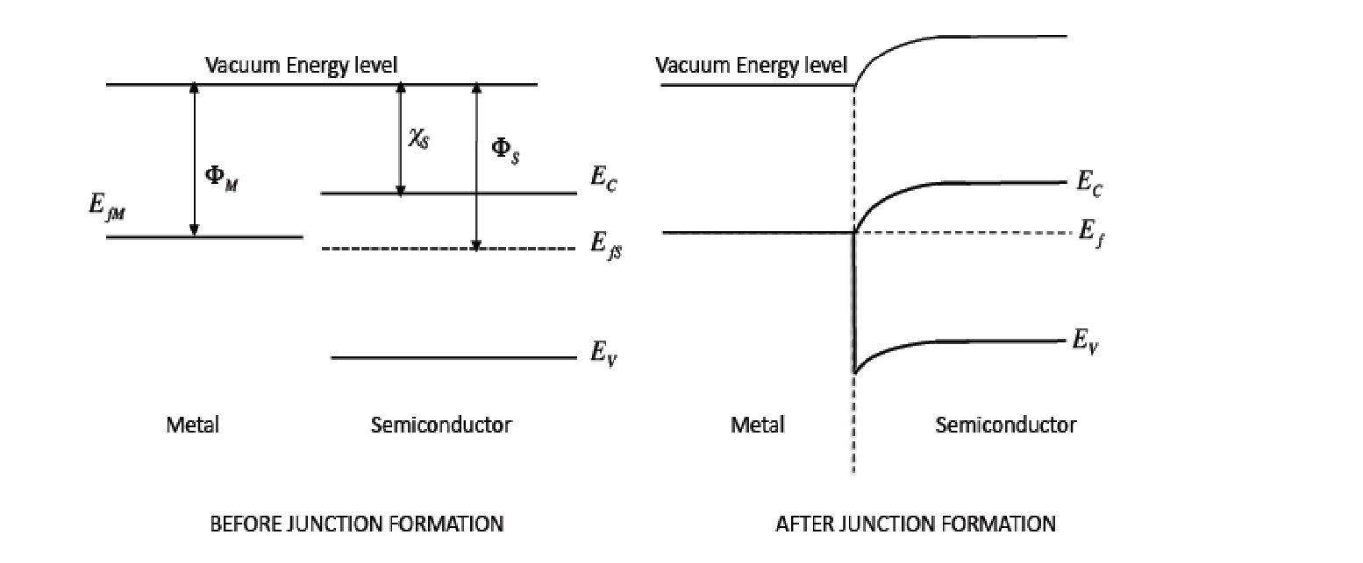
The formation of a ohmic Metal-Semiconductor junction
The formation of a ohmic Metal-Semiconductor junction. The semi conductor is N type

Slide 28
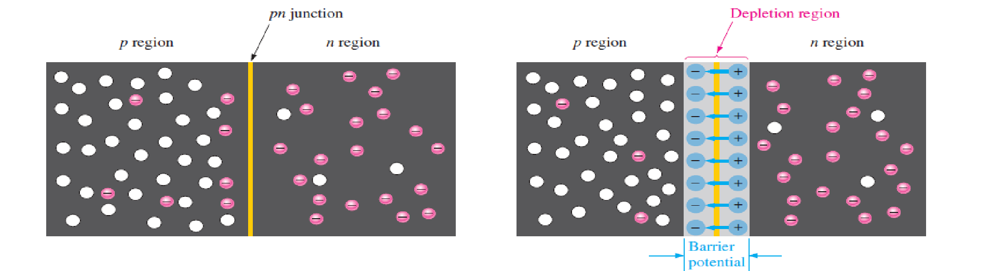
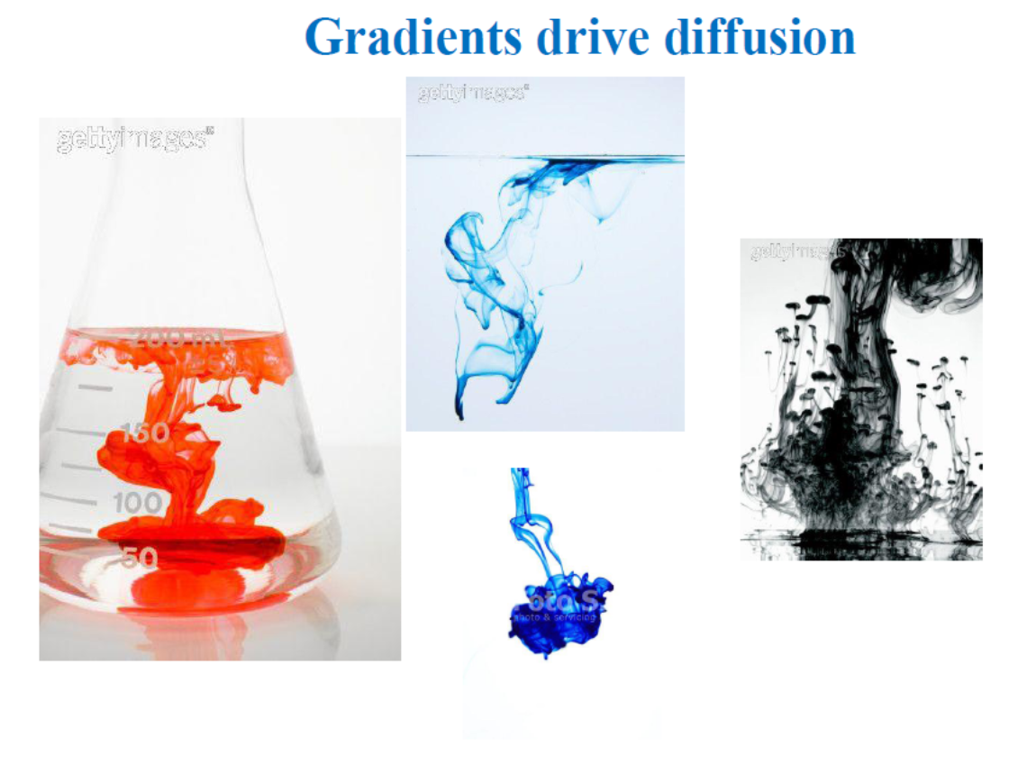

P-N Junction

Slide 29

Mass-Action Law
If we consider a semiconductor in thermal equilibrium, free charge carriers are continuously created due to the presence of thermal energy. The generation rate of free charge carriers is G = g(T), and is purely a function of the temperature and the properties of the semiconductor crystal lattice.
The generation of electron and holes in the semiconductor is balanced by their recombination and this balance of generation and recombination maintains thermal equilibrium in
the semiconductor.
The recombination is proportional to R = npr(T), where r(T) is again purely a function of temperature and crystal property. Equating the generation and recombination rates, np = g(T)/r(T)
Mass-Action Law

Slide 30


Slide 31


Slide 32


Slide 33


Slide 34

Energy band diagram of a pn junction before and after

Slide 35



Forward Biasing
Band bending diagram for PN junction diode
Reverse Biasing
At the junction the electrons and holes combine so that a continuous current can be maintained.

Slide 36

Diode

Slide 37

P-N Junction
We create a p-n junction by joining together two pieces of semiconductor, one doped n-type, the other p-type.

Slide 38

Diffusion Current

Slide 39

Diffusion Current
The diffusion current along the x-direction depends on the gradient of carrier concentration in this direction denoted by the first differentials dn/dx and dp/dx.

Slide 40

Drift Current

Slide 41

Drift Current
The drift velocity is proportional to the applied electric eld and the constant of proportionality is called the electron mobility defined as
µ_{e} = qτ_{me}=m_{e}

Slide 42

Total Current

Slide 43

PN diode solution

Slide 44

Diode Current

Slide 45

Diode Current

Slide 46

V-I characteristics
Knee Voltage or Cut-in Voltage
It is the forward voltage at which the diode starts conducting.
Breakdown Voltage
It is the reverse voltage at which the diode
(p-n junction) breaks down with a suddenrise
in reverse current.

